Slide 1
PCAP Analysis with
ElK stack
Vinoth A

Slide 2
System Overview
For network administrators and security analysts, one of the most important capabilities is packet capture and analysis. Being able to look into every single piece of metadata and payload that went over the wire provides very useful visibility and helps to monitor systems, debug issues, and detect anomalies and attackers.
Packet capture can be ad hoc, used to debug a specific problem. In that case, only the traffic of a single application or a single server might be captured, and only for a specified period of time. Or it can be extensive, for example using an outside network tap to capture all traffic.
While network traffic itself is sent in a binary format, each packet contains many different fields that using proper tools can be parsed out into numbers, text, timestamps, IP addresses, etc. All of this is data that can be stored in Elasticsearch and explored, searched and visualized in Kibana.

Slide 3
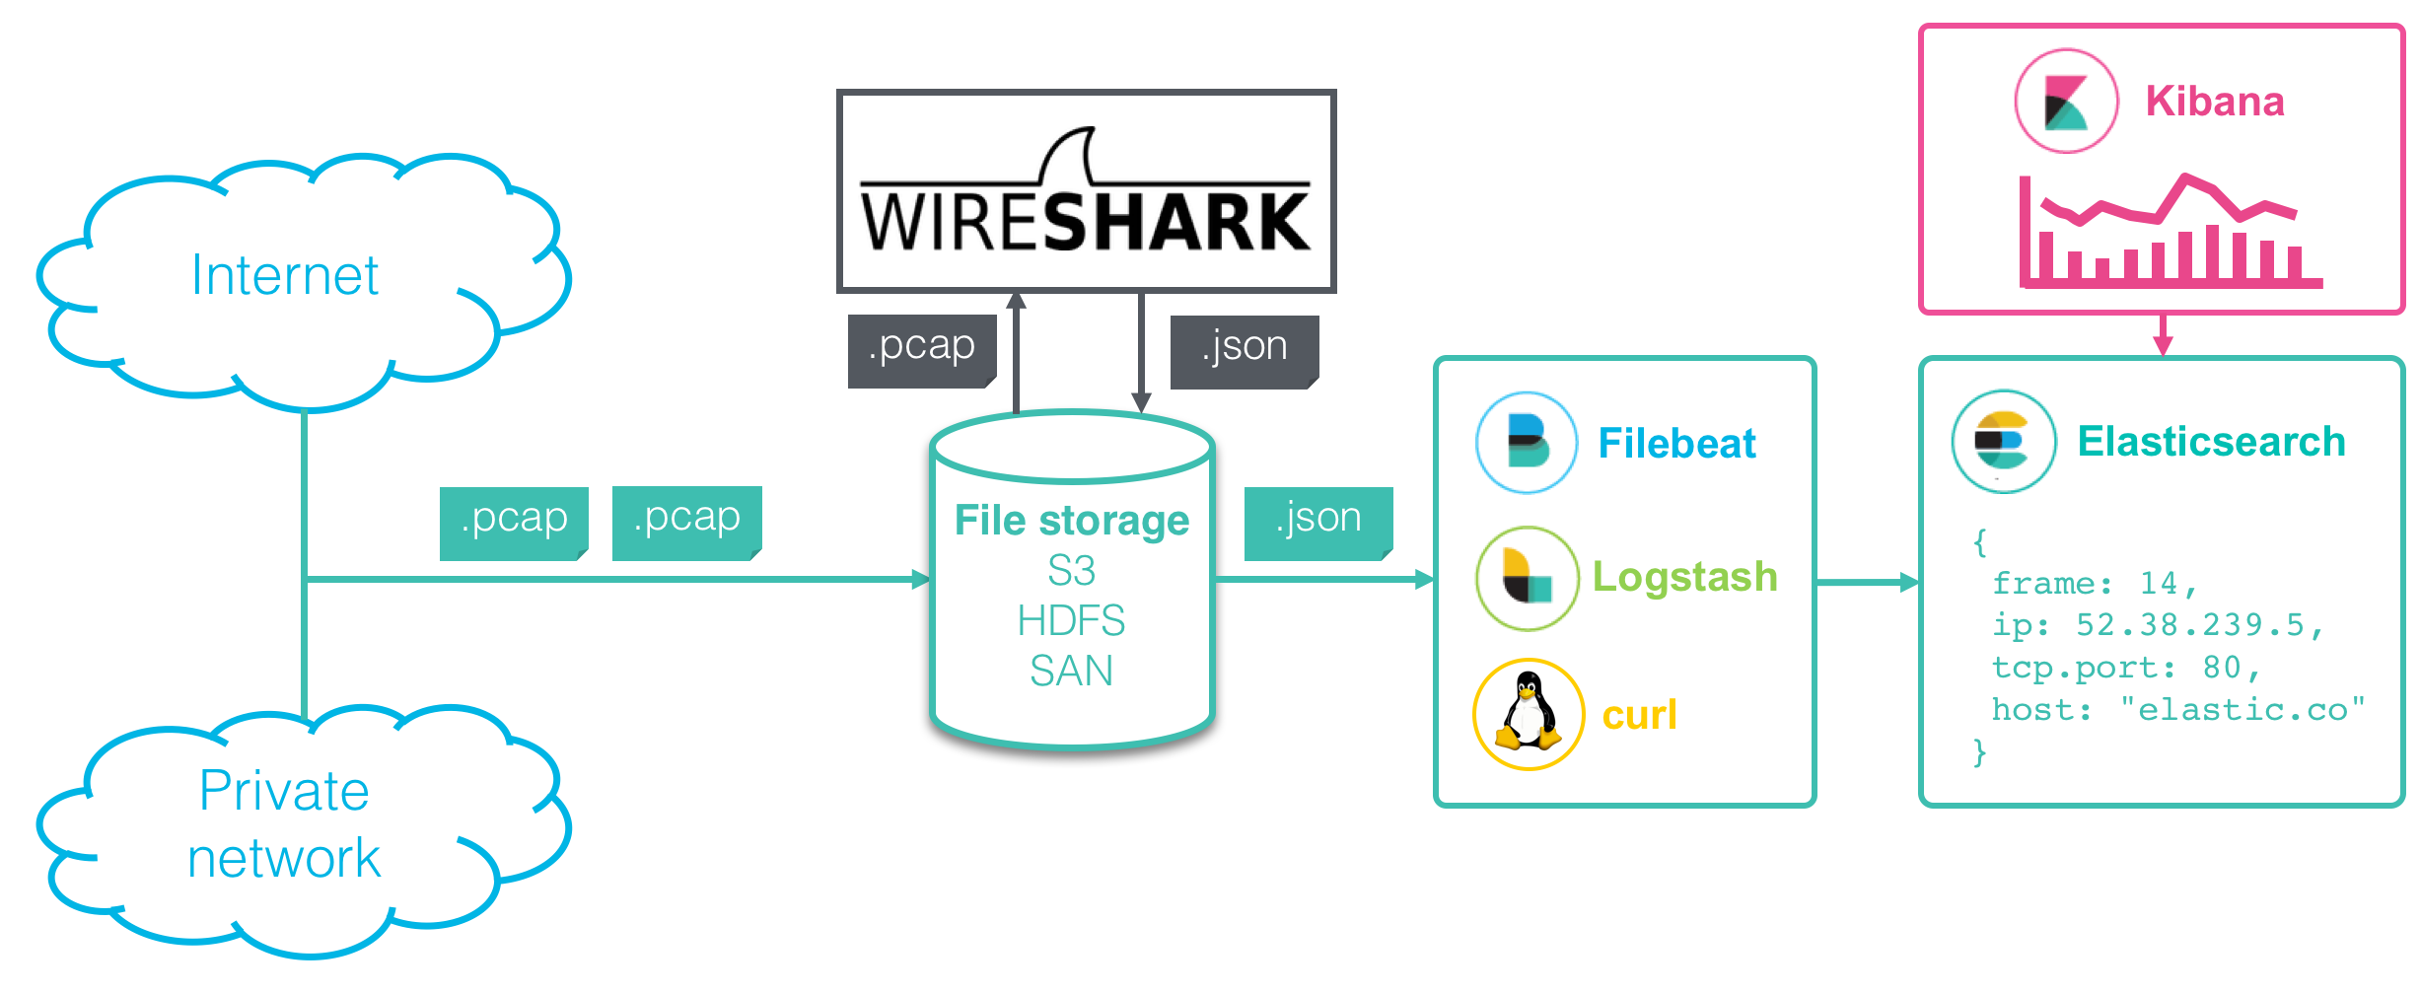
Data Pipeline
1. Packet capture - Recording the packet traffic on a network. 2. Protocol parsing - Parsing out the different network protocols and fields. 3. Search and Visualize - Exploring the data in detail or in aggregate.

Slide 4
Software Information
1.Elasticsearch (v 7.0.1)
2. Kibana
3.Wireshark
4.Python ES Client

Slide 5
Hardware Information
A Cluster with 3 instances
Data Instance #0 : Disk : 120 GB
RAM : 4 GB
Data Instance #1 : Disk :120 GB
RAM : 4 GB
Master Instance #2 : Disk : 2 GB
RAM : 1 GB

Slide 6
Implementation
Step 1:Traffic analyzer will send the bad traffic to the file system in “.pcap” format after analyzing the traffic
Step 2 : A folder watcher software will keep watching the file system and checks whether new files are coming or not to the file system
Step 3: if new file comes to the file system, the watcher will decodes the .pcap file into json format and move the json file to “jsonfolder” directory
Step 4: Another watcher will keep watching the “jsonfolder ” directory ,and seeks for new file to that directory
Step 5 : After getting the decoded fiile in “jsonfolder ” directory, the watcher immediately sends data to the elasticsearch

Slide 7
Folder Structure of the System
Directories:
1.Pcapfiles_folder : (will get .pacp files)
2.Jsonfiles_folder : ( will get .json files)
Watchers:
Pcapfolder_watcher.py ( watches the “pcapfile_folder” directory)
Jsonfoler_watcher.py (watchers the “json_folder” directory)

Slide 8
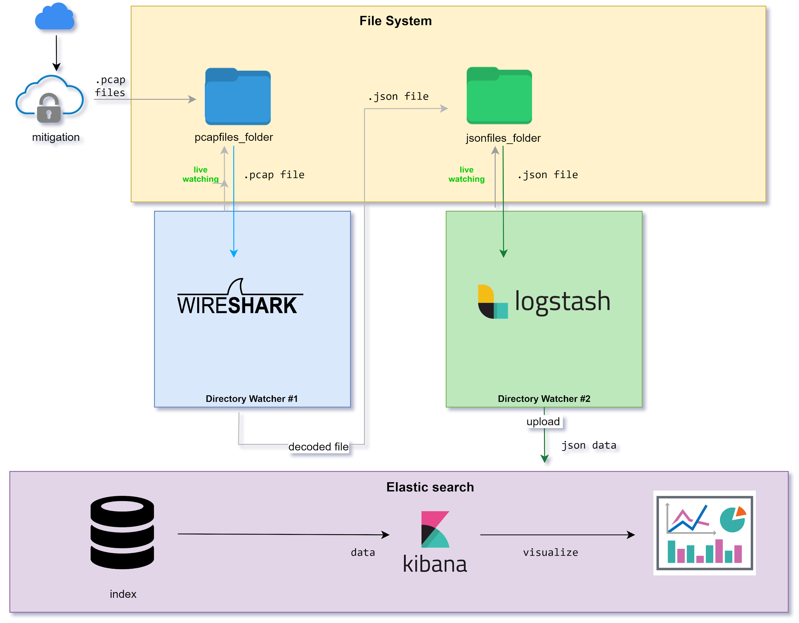
System Architecture

Slide 9
Testing the system
Test : Stressing the elasticsearch for 24 hours continuously
Process: For every single second pcap file with random number packets is generated using Scapy , after decoding to json using tshark, the json data is uploaded into the elasticsearch using _bulk API
Observation: Elasticsearch condition is healthy (green) after 24 hours of testing
Result : Passed

